Slide 1
South African Turtles, Terrapins and Tortoises
23 July 2020
Dr Ernst Baard
Director: Conservation Operations

Slide 2
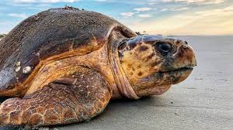
South African Turtles
South Africa has five of the seven kinds of sea turtles occurring in its coastal and off-shore waters
Green turtle
Hawksbill turtle
Loggerhead turtle
Olive ridley turtle
Leatherback turtle
Loggerheads & Leatherbacks nest on Maputoland Coast
All seven kinds of sea turtles in the world are threatened; harvesting of eggs, loss of nesting beaches, trawling and longline fishing

Slide 3
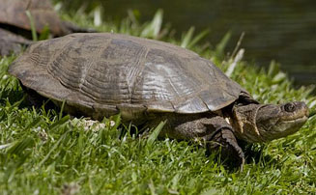
South African Terrapins
South Africa has six kinds of freshwater terrapins
Cape terrapin
Marsh terrapin
Yellow-bellied hinged terrapin
Variable hinged terrapin
Serrated hinged terrapin
Black-bellied hinged terrapin
All abundant and not considered threatened,
Several cryptic (“hidden”) kinds in hinged terrapins

Slide 4
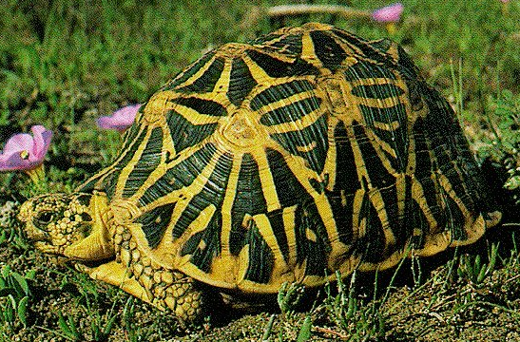
South African Tortoises
45 kinds of tortoises worldwide;
13 kinds in South Africa (30%)
8 kinds of tortoises in Western Cape; most anywhere in same area!
4 kinds threatened with extinction
Geometric tortoise
Speckled padloper
Karoo padloper
Tent tortoise

Slide 5
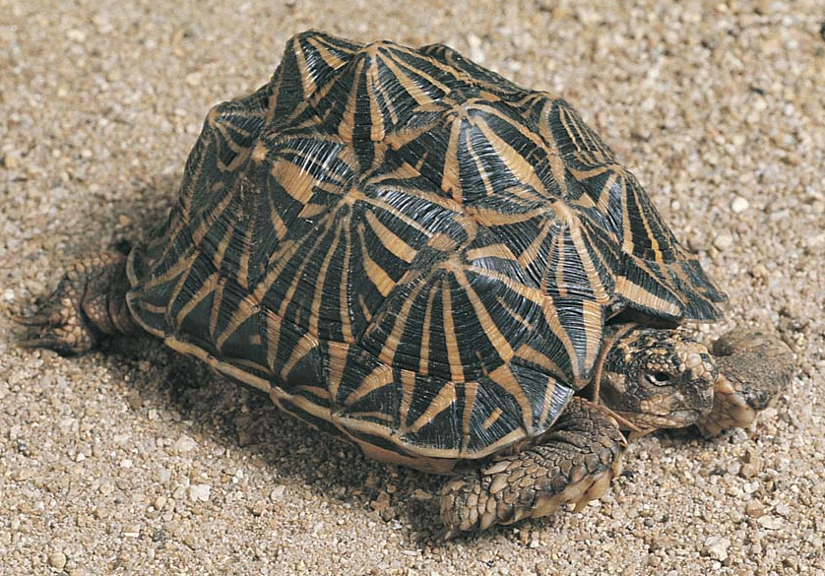
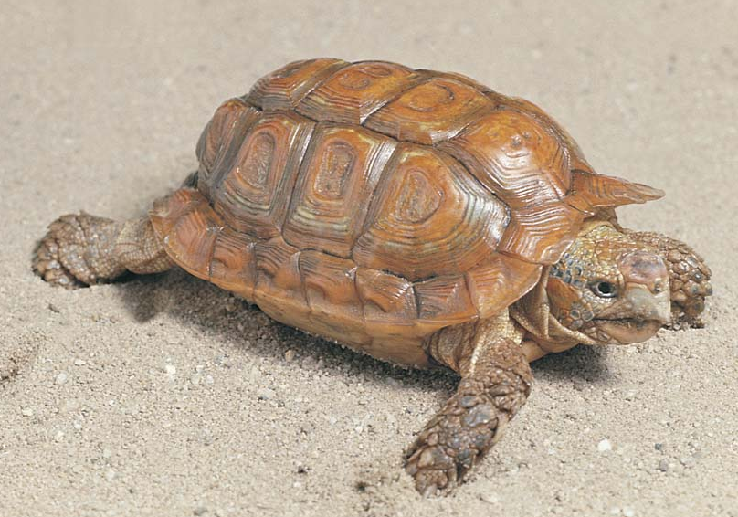
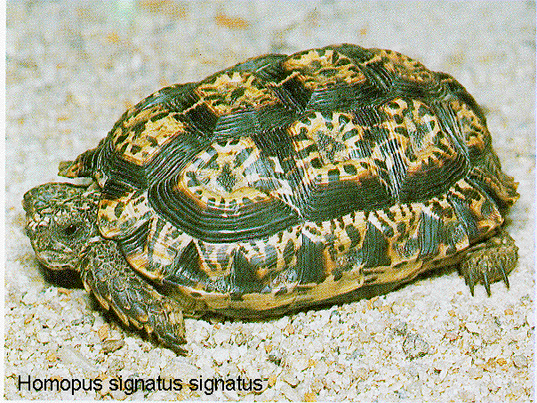
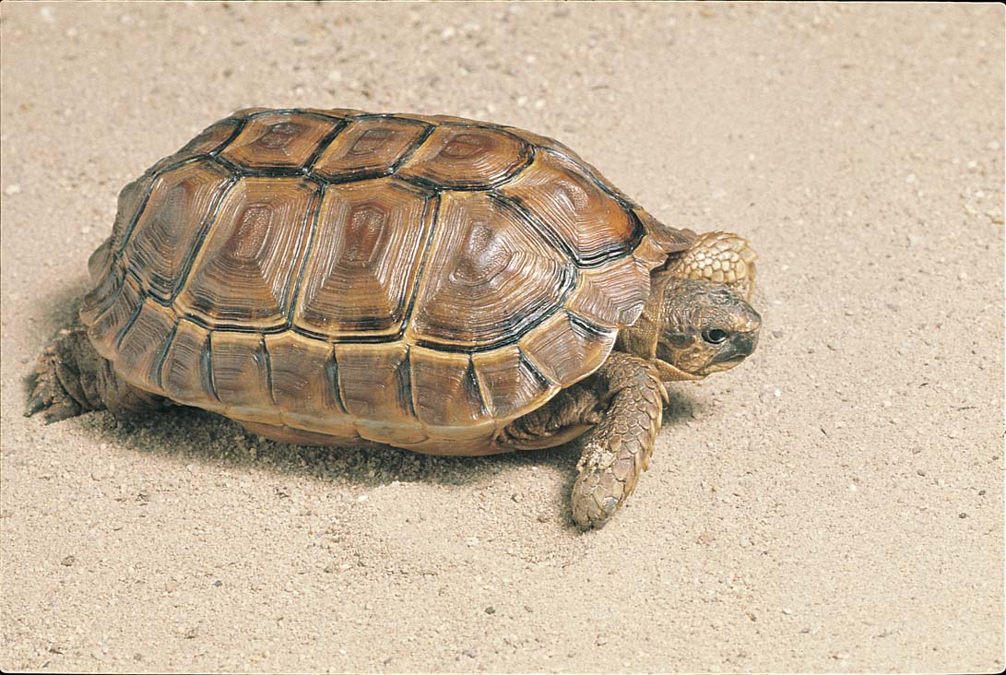
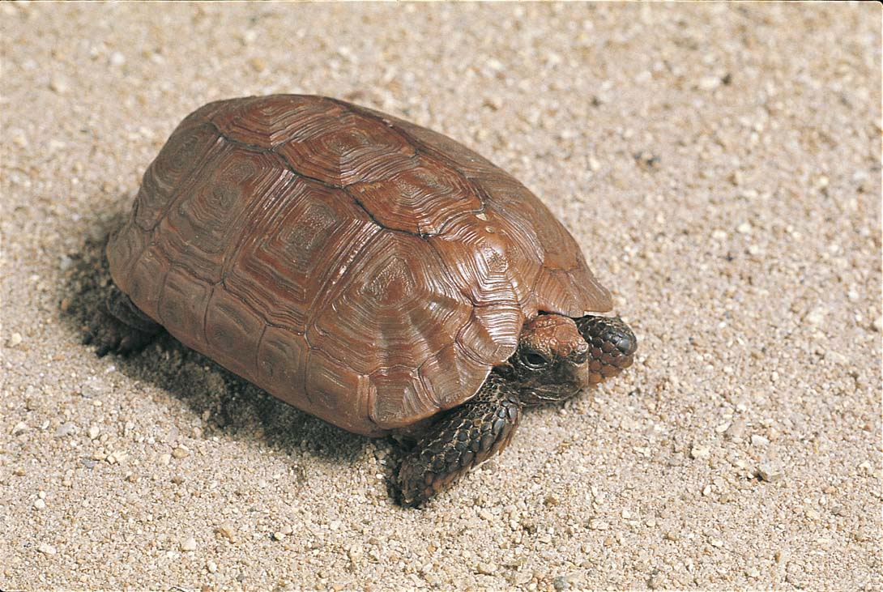
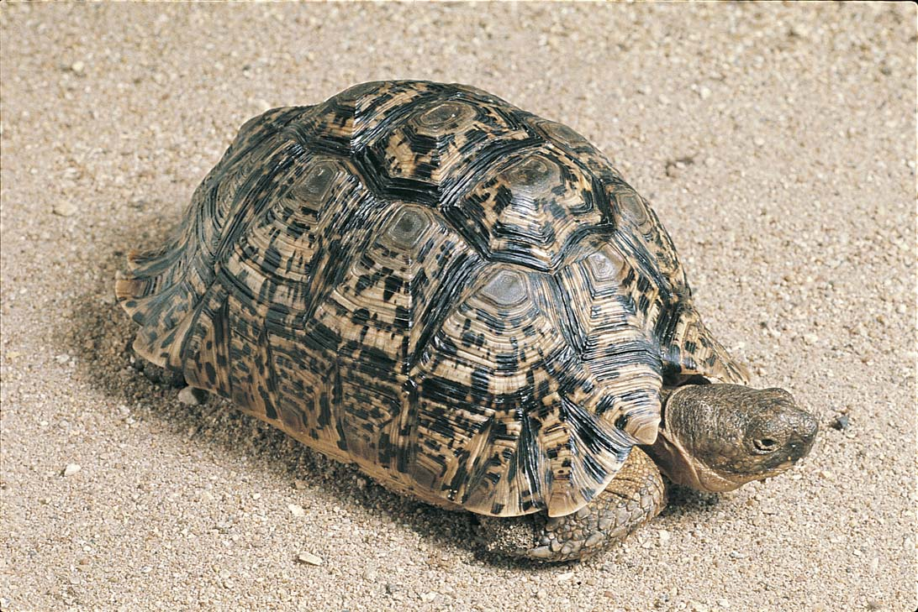
Geometric tortoise
Tent tortoise
Common padloper
Geometric tortoise
Speckled padloper
Greater padloper
Karoo padloper
Leopard tortoise
Angulate tortoise

Slide 6
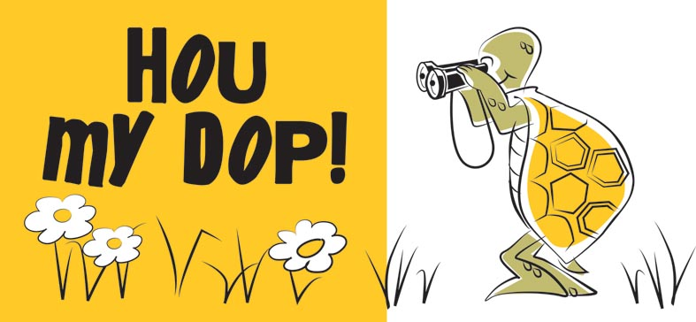
Watch out for our tortoises on the roads!!
They are not lonely! Do not take them home!

